Slide 1

Optimising Predictors for Inflation using AI
Zack Foreman

Slide 2
Predicting Inflation
Importance
Price Stability (Bernanke and Mishkin, 1997)
Conditions for Economic Growth
Increasing Interest rates
Traditional Methods
Phillips Curve
Model Misspecification

Slide 3
Machine Learning Methods
Supplement traditional methods
RNN + LSTM for sequential processing
Dropout

Slide 4
Methodology
12 months of previous Data
Datasets
CPIH
Unemployment
GDP
Bank Rate
Housing Market
Exchange Rate

Slide 5
Predictors
CPIH
ONS headline measure
ONS Monthly data from 1989 to 2022
Supplement other predictors
Unemployment
High Unemployment, low Inflation
ONS Monthly data from 1972 to 2022
GDP
High Inflation, low GDP
ONS Monthly data from 1997 to 2022
Bank Rate
High Bank Rate, low Inflation
Bank of England data from 1976 to 2022
Housing Market
High Inflation, high Housing Prices
GOV Statistical data from 1968 to 2022
Exchange Rate (USD)
Low Inflation, high Purchasing Power
Bank of England data from 1976 to 2022

Slide 6
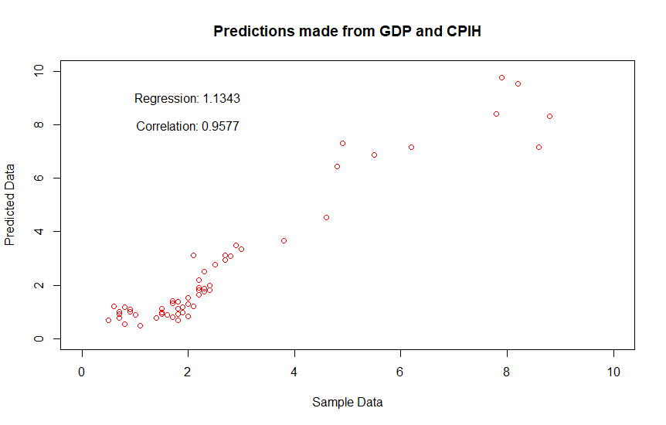
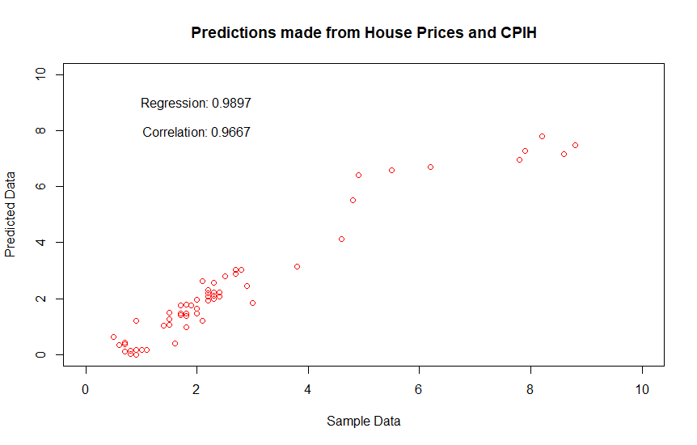
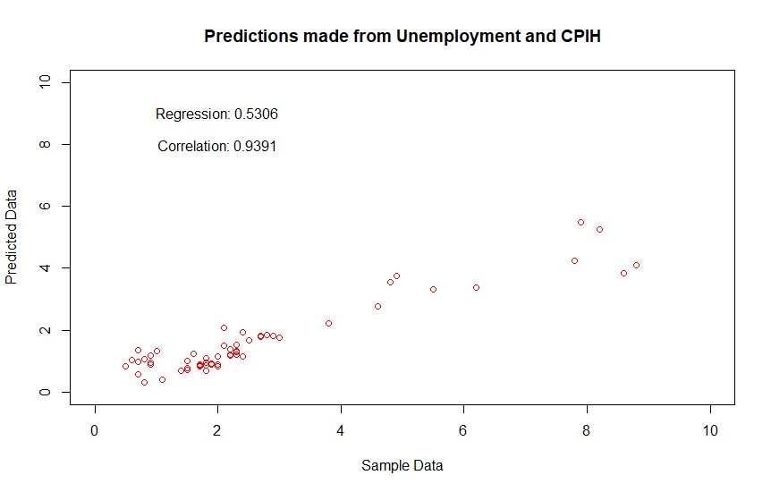
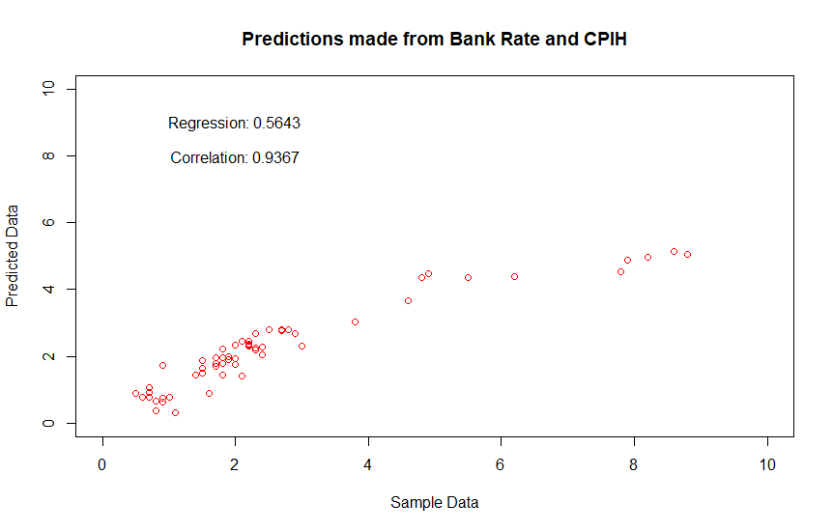
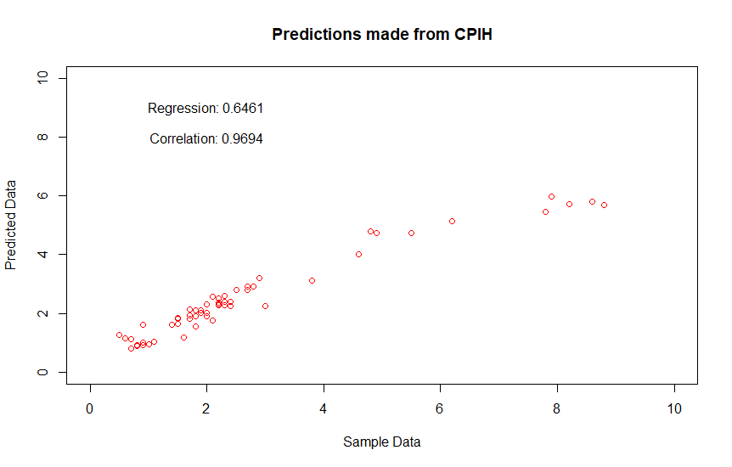
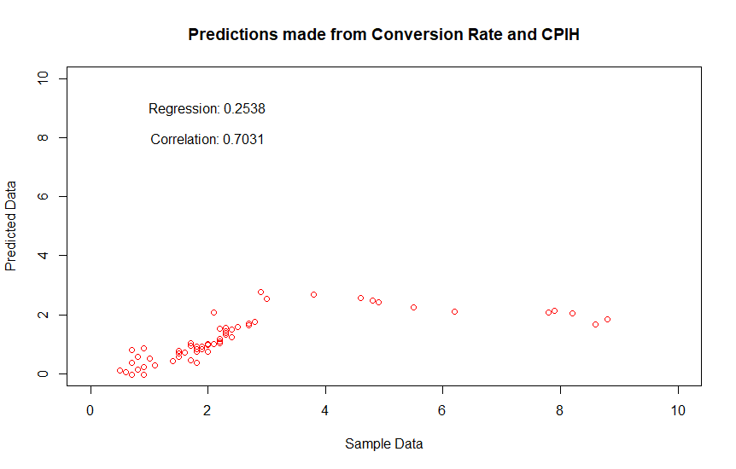
Results

Slide 7
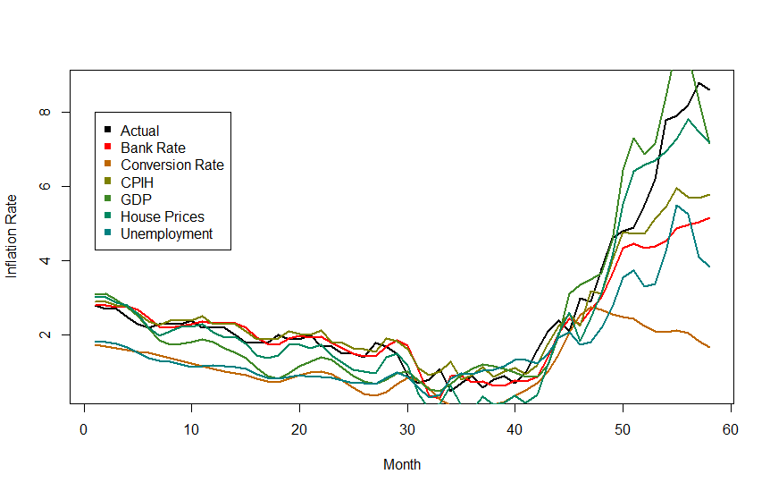
Results
Bank Rate RMSE = 1.078863
Conversion Rate RMSE = 2.196232
CPIH RMSE = 0.8279836
GDP RMSE = 0.7653077
House Prices RMSE = 0.6064539
Unemployment RMSE = 1.458169

Slide 8
Comparison to Traditional Methods
Neural Network with LSTM 1 month horizon - 0.98 (Paranhos, 2020)
Artificial Neural Network with 1 month horizon - 1.26 (Joseph, 2021)
Random Forest Regression 60 data points - 0.586 (Kohlscheen, 2021)

Slide 9
Improvements
Increase Predictors
Increase length of Dataset
Decision Trees

Slide 10
References
Bernanke, B and Mishkin, F (1997), ‘Inflation Targeting: A New Framework for Monetary Policy?’, Journal of Economic Perspectives, vol. 11, no. 2, pp. 97-116
Joseph A, Potjagailo G, Kalamara E, Chakraborty C and Kapetanios G (2021) ‘Forecasting UK inflation bottom up’, Bank of England Staff Working Paper No. 915
Kohlscheen E (2021), ‘What does machine learning say about the drivers of inflation?’ BIS Working Papers No. 980
Paranhos, L (2020), ‘Predicting Inflation with Neural Networks’ [PowerPoint presentation], Available at: https://www.bankofengland.co.uk/-/media/boe/files/events/2020/november/modelling-with-big-data-event-livia-paranhos-presentation.pdf (Accessed: 12 December 2022)

